Slide 1
ABC of Platform Workspace
Szymon Brandys
Tomasz Zarna
IBM Krakow Software Lab

Slide 2
Introduction
Workspace components
  Resources
  Compare
  Team
  CVS

Slide 3
Resources overview
An essential plug-in for Eclipse IDE applications is the resources plug-in (named org.eclipse.core.resources).
The resources plug-in provides services for accessing the projects, folders, and files that a user is working on.
The resources plug-in provides services for managing meta-data associated with resources (Markers: breakpoints, tasks, bookmarks, etc and Properties: arbitrary objects associated with resources)

Slide 4
Compare, Team and CVS overview
Compare
  comparison of alternate states of a file system
Team
  repository tooling integration into Eclipse
CVS
  implementation of a CVS client

Slide 5
Agenda
Team/Compare
  Repository Integration Framwork
  Compare Framework
  Demo
Summary and questions
Resources
  Workspace
  Resources
    Properties
    Preferences
    Content types
    Linked resources
    Markers
  Natures
  Builders
  Alternate file systems
  Demo

Slide 6
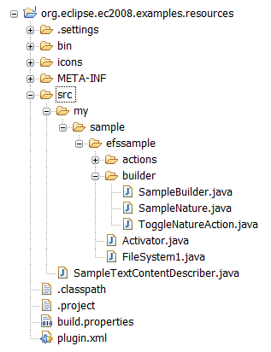
Workspace
Workspace is a central hub for user’s files
The workspace contains a collection of resources. From the user perspective there are three different types of resources: projects, folders, files. Resources are organized in a tree.
The resources plug-in provides APIs for creating, navigating, and manipulating resources in a workspace. The workbench uses these APIs to provide this functionality to the user. Your plug-in can also use these APIs.
Derived resources
are resources that are not original data, and can be recreated from their source files. It is common for derived files to be excluded from certain kinds of processing.

Slide 7
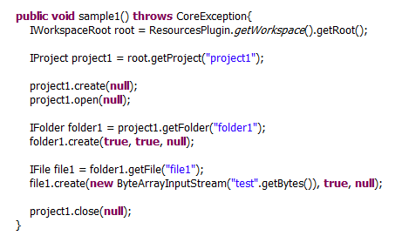
Resources API
  © Copyright 2008 IBM Corp. All rights reserved. This source code is
  made available under the terms of the Eclipse Public License, v1.0.

Slide 8
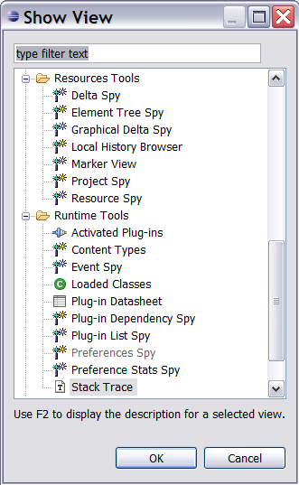
Some useful tools
See the modules in dev.eclipse.org repository
org.eclipse.core.tools
org.eclipse.core.tools.resources

Slide 9
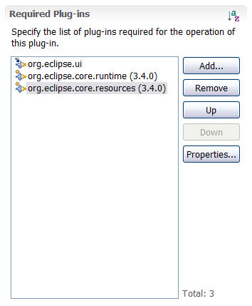
Basic plug-in
Dependency to org.eclipse.core.runtime
Content types
Dependency to org.eclipse.core.resources
Resource operations
Builder framework
Natures
Dependency to org.eclipse.core.filesystem
EFS

Slide 10
Properties
Properties can be used to store meta-information about the resource. This mechanism can be used in user plug-ins to hold information specific for that plug-in.
When a resource is deleted, its properties are deleted too.
There are two kinds of properties
Session properties
  allow your plug-ins to easily cache information about a resource in key-value pairs
  the values are arbitrary objects
  these properties are maintained in memory and lost when a resource is deleted from the workspace, or when the project or workspace is closed
Persistent properties
  store information on disc in the workspace metadata
  the value of a persistent property is an arbitrary string
  the strings are intended to be short (under 2KB)
  Properties are maintained across platform shutdown and restart
To manipulate properties API is provided (see IResource class)

Slide 11
Project preferences
Preferences in Eclipse (short overview)
Eclipse provide the infrastructure for defining and storing preferences with different scopes and org.eclipse.core.runtime.preferences extension can be used to define additional scopes for preferences.
Preferences typically map to settings controlled by the user on the Preferences page, although this is not required by the underlying infrastructure. Plug-in preferences are key/value pairs, where the key describes the name of the preference, and the value is one of several different types (boolean, double, float, int, long, or string). Preferences can be stored and retrieved by the platform from the file system. The exact location of the saved preferences depends upon the scope of the preference.
The platform resources plug-in defines its own preference scope for projects. Project-scoped preferences are stored in a file located inside the project.
Using project scope preference

Slide 12
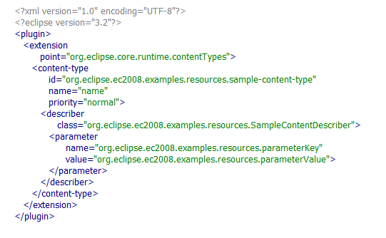
Content types
What is content type?
There are some features of Eclipse
that are content-sensitive, such as automatic encoding determination, editor selection, and menu contributions.
The content type registry is extensible so plug-ins can contribute new content type definitions.
How to define new content type
  © Copyright 2008 IBM Corp. All rights reserved. This source code is
  made available under the terms of the Eclipse Public License, v1.0.

Slide 13
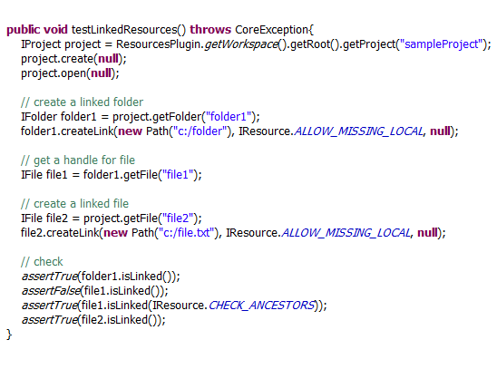
Linked resources
Linked resources are provided so that files and folders inside a project can be stored in a file system outside of the project's location.
  © Copyright 2008 IBM Corp. All rights reserved. This source code is
  made available under the terms of the Eclipse Public License, v1.0.

Slide 14
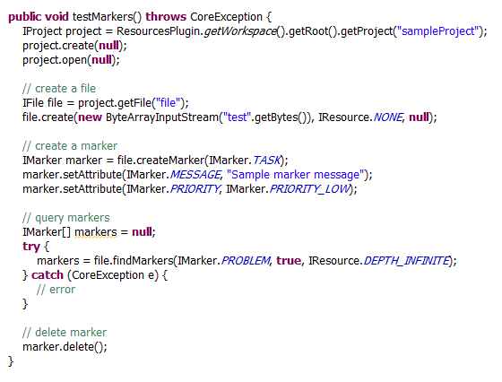
Markers
What is Marker?
A marker is an extra note stuck to a resource. On the marker you can record information about a problem or a task to be done.
How to manipulate markers?
How to add new marker type
Plug-ins can declare their own marker types using the org.eclipse.core.resources.markers extension point.
  © Copyright 2008 IBM Corp. All rights reserved. This source code is
  made available under the terms of the Eclipse Public License, v1.0.

Slide 15
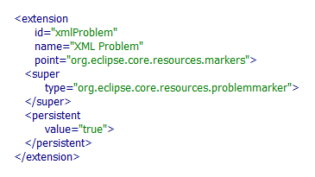
Markers (subtypes)
  © Copyright 2008 IBM Corp. All rights reserved. This source code is
  made available under the terms of the Eclipse Public License, v1.0.

Slide 16
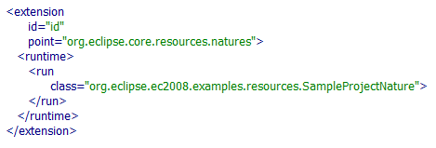
Natures
Project natures allow to mark a project as a specific kind of project. This mechanism can be used to add a specific behaviour to projects.
A project can have more than one nature. However, when you define a project nature, you can define special constraints for the nature
Constraints:
  one-of-nature
  requires-nature
Plug-ins can contribute implementations for natures using the org.eclipse.core.resources.natures extension point and supplying a class which implements IProjectNature
  © Copyright 2008 IBM Corp. All rights reserved. This source code is
  made available under the terms of the Eclipse Public License, v1.0.

Slide 17
Natures – why use them?
Configure and deconfigure when a nature is added/removed to a project (oportunity to add additional attributes to projest. Modify its metadata, add builders)
propertyPages and popupMenus have filter mechanism which recognizes natures

Slide 18
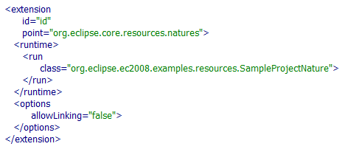
Linked resources and natures
What if a plug-in is not able to handle linked resources?
  © Copyright 2008 IBM Corp. All rights reserved. This source code is
  made available under the terms of the Eclipse Public License, v1.0.

Slide 19
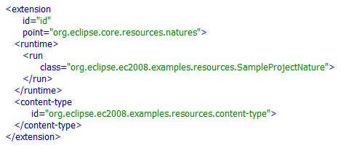
Content types and natures
Natures can declare affinity with arbitrary content types, affecting the way content type determination happens for files in the workspace.
In case of conflicts, the content type having affinity with any of the natures configured for the corresponding project will be chosen.
  © Copyright 2008 IBM Corp. All rights reserved. This source code is
  made available under the terms of the Eclipse Public License, v1.0.

Slide 20
Builders
An incremental project builder is an object that manipulates the resources in a project in a particular way.
Builders can apply a transformation on resources.
Resources created by a builder are typically marked as derived resources.
From an API point of view, the platform defines two basic types of builds:
  A full build
  An incremental build
Plug-ins can contribute implementations for builder using the org.eclipse.core.resources.builders extension point and supplying a class which extends IncrementalProjectBuilder.

Slide 21
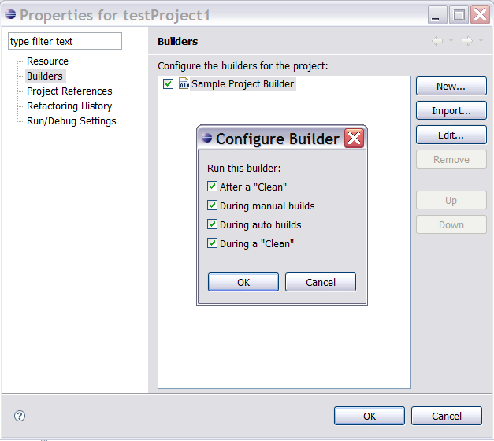
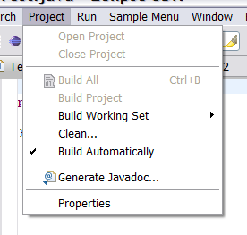
Builders and UI

Slide 22
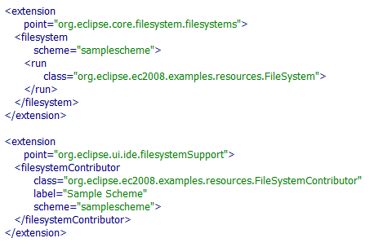
Alternate file systems
What is EFS?
EFS (The Eclipse FileSystem) is an abstract filesystem API that allows to work with other filesystems e.g. FTP, zip files, in-memory filesystem, and even CVS.
File system providers
By default, the org.eclipse.core.filesystem plug-in only includes a file system implementation for the local file system.
Plug-ins can contribute implementations for other file systems using the org.eclipse.core.filesystem.filesystems extension point. File system providers must provide subclasses of FileStore and FileSystem.
UI support for EFS
There are several places in the UI where the user can select file system, e.g. wizards.
The UI support for EFS can be added via the org.eclipse.ui.ide.fileSystemSupport extension point.
The class attribute of these schema must be a org.eclipse.ui.ide.fileSystem.FileSystemContributor which is used to supply validation and browsing of the other file systems.
Additional resources on EFS
http://wiki.eclipse.org/index.php/EFS
  © Copyright 2008 IBM Corp. All rights reserved. This source code is
  made available under the terms of the Eclipse Public License, v1.0.

Slide 23

Demo

Slide 24
Additional info and details
Eclipse SDK Help
  Platform Plug-in Developer Guide > Programmer’s Guide > Resource Overview
  Platform Plug-in Developer Guide > Programmer’s Guide > Advanced Resource Concepts
Examples
  org.eclipse.ui.examples.filesystem

Slide 25
Overview
The Repository Integration Framework
The Compare Framework
Demo

Slide 26
Repository Integration Framework
Goal
  Integrate the workflow that your repository users know with the concepts defined in the workbench (not just API)
Example
  The CVS client as a case study for integrating a team provider with the platform

Slide 27
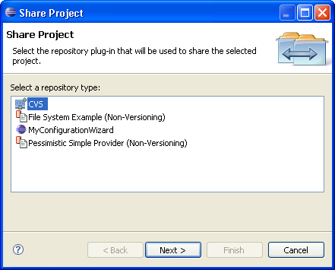
Repository Provider
Define a RepositoryProvider
  org.eclipse.team.core.repository
  Subclass org.eclipse.team.core.RepositoryProvider
Provide a configuration wizard for sharing projects
  org.eclipse.team.ui.configurationWizard

Slide 28
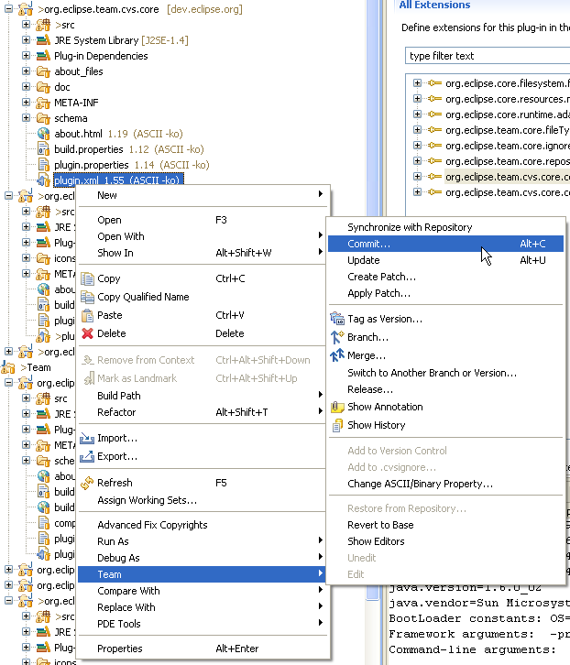
Functionality in a resource’s menu
Add actions to the Team menu
  org.eclipse.ui.popupMenus

Slide 29
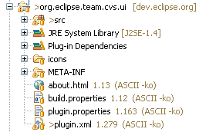
Decorate resources
Decorate resources with team specific information
  org.eclipse.ui.decorators
  org.eclipse.team.ui.teamDecorators

Slide 30
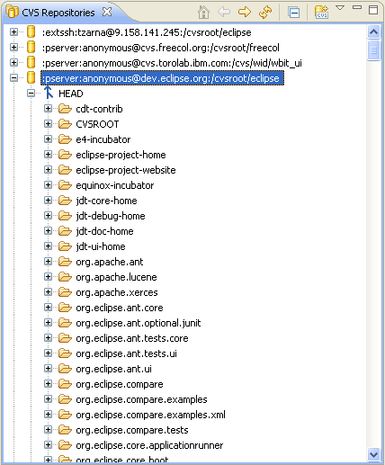
Views
Provide customized view with team specific information
  CVS Editors
  CVS Repositories
  History
  Synchronize
org.eclipse.ui.views

Slide 31
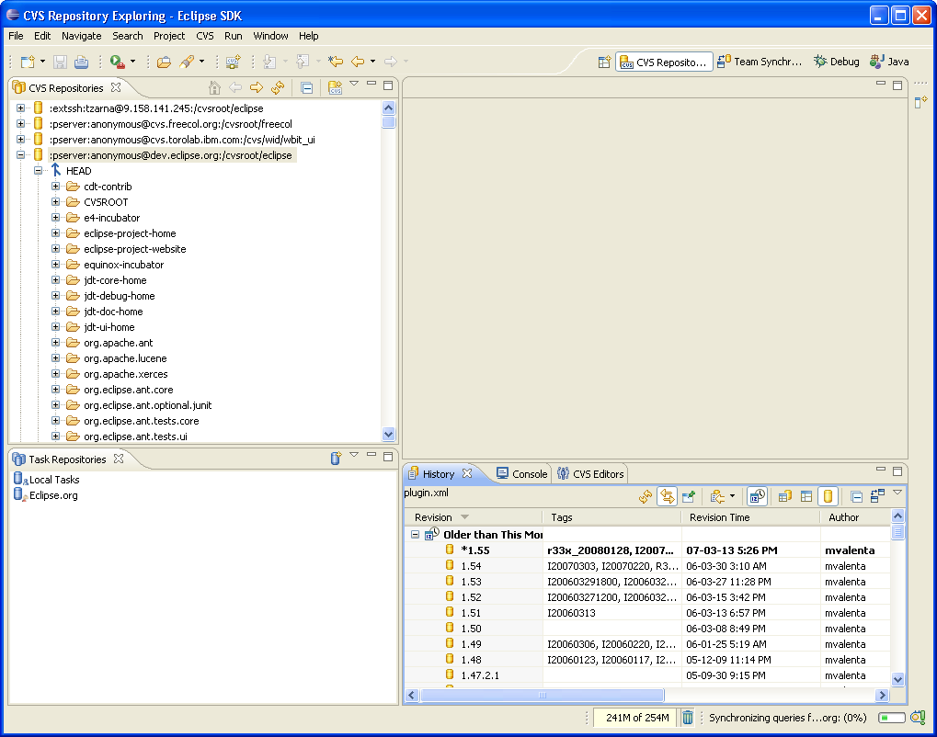
Perspectives
Team oriented perspective
  org.eclipse.ui.perspectives

Slide 32
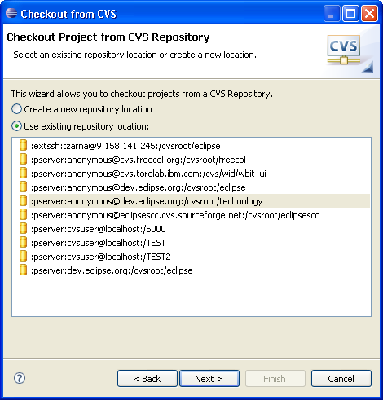
Wizards
Import/Export
  org.eclipse.ui.importWizards
  org.eclipse.ui.exportWizards
New
  org.eclipse.ui.newWizards
Share
  org.eclipse.team.ui.configurationWizards
Synchronize
  org.eclipse.ui.synchornizeWizards

Slide 33
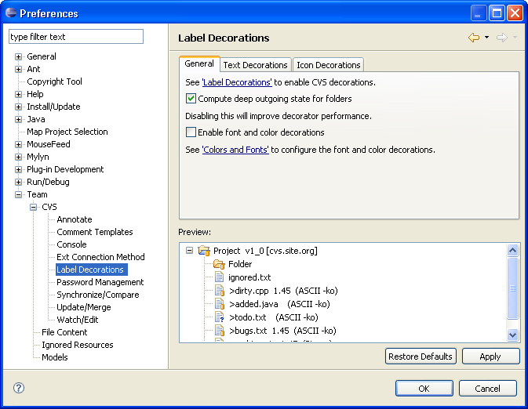
Preferences
org.eclipse.ui.preferencePages
Category: org.eclipse.team.ui.TeamPreferences

Slide 34
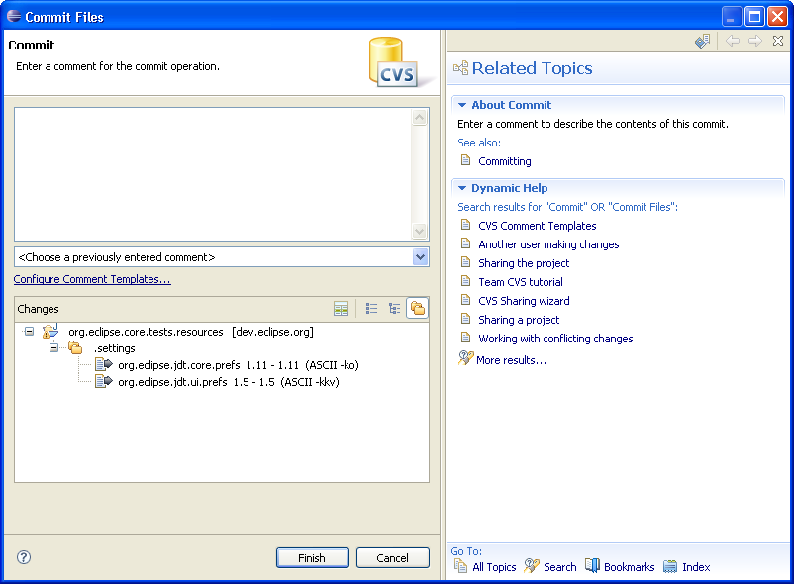
Help

Slide 35
Additional info and details
Eclipse SDK Help
  Platform Plug-in Developer Guide > Team Support > Rich Team Integration
  http://help.eclipse.org/stable/index.jsp?topic=/org.eclipse.platform.doc.isv/guide/team_howto.htm
Examples:
  org.eclipse.team.examples.filesystem
  org.eclipse.team.cvs.*
Repository projects supporting Eclipse
  http://www.eclipse.org/community/team.php

Slide 36
The Compare Framework
What is the purpose of the Compare framework?
  Support comparison of alternate states of a file system or data store
What does the Compare framework provide?
  API to define the input to a comparison
  Extensions for associating viewers with input types
  Containers to host comparisons in the UI

Slide 37
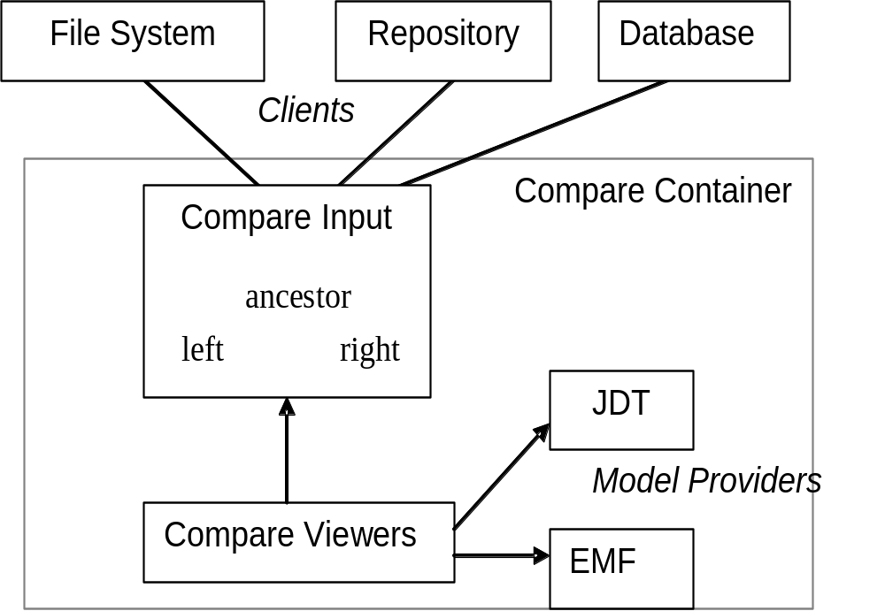
Overview of Compare Architecture

Slide 38
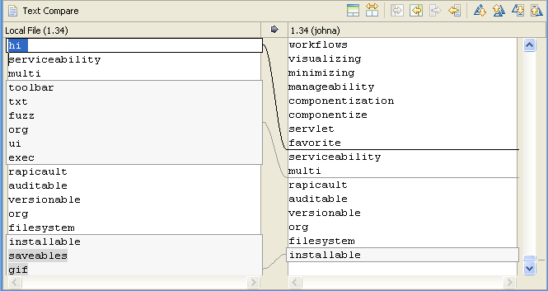
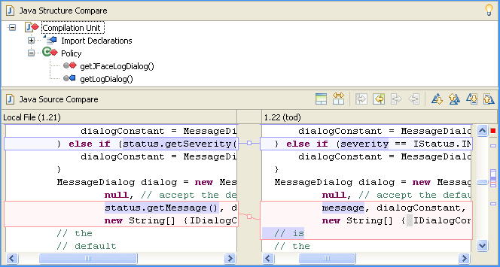
Compare/Merge viewers
A simple text merge viewer and the JDT merge viewer

Slide 39
How to create the simplest compare editor?
Ingredients:
  A CompareItem that implements
    ITypedElement for name, image and content type of the object
    IModificationDate for timestamp
    IStreamContentAccessor to supply the content
  CompareEditorInput subclass
  DiffNode computed in a CompareEditorInput subclass
  To specify which of the panes is editable use CompareConfiguration
  An action to open the editor
  A contribution in org.eclipse.ui.popupMenus extension point

Slide 40
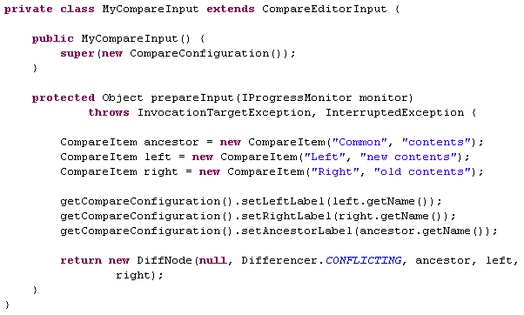
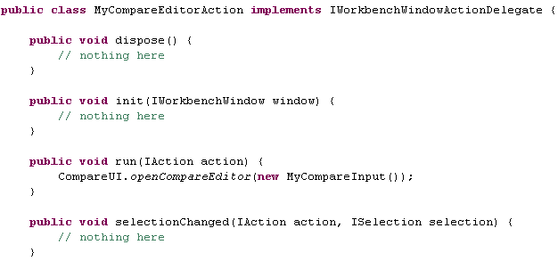
The input and the action
© Copyright 2008 IBM Corp. All rights reserved. This source code is made available under the terms of the Eclipse Public License, v1.0.

Slide 41
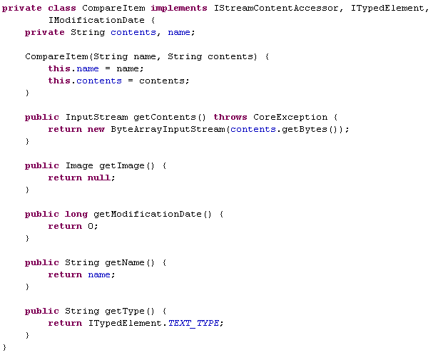
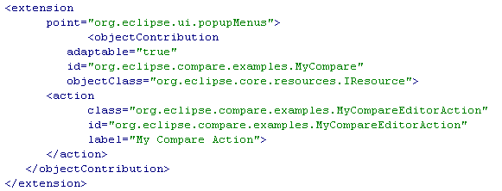
The item and the popup menu entry
© Copyright 2008 IBM Corp. All rights reserved. This source code is made available under the terms of the Eclipse Public License, v1.0.

Slide 42
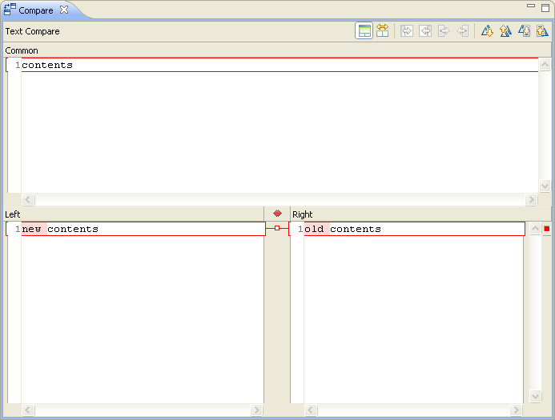
The result

Slide 43
How do I provide a structure merge viewer?
Add an extension of structureMergeViewer
  Provide instance or subclass of StructureDiffViewer
Add an extension of structureCreator
  Provide a instance of IStructureCreator
    Provides the structure of a single element (e.g. file)
      i.e. a tree representation of the element
      Nodes are subclasses of DocumentRangeNode
      Need a unique type (“java2” for java)
    Also provides API to write changes back to the element
    Subclass StructureCreator to be file buffer aware
  Viewer uses the differencing engine to create a tree representation of the differences

Slide 44
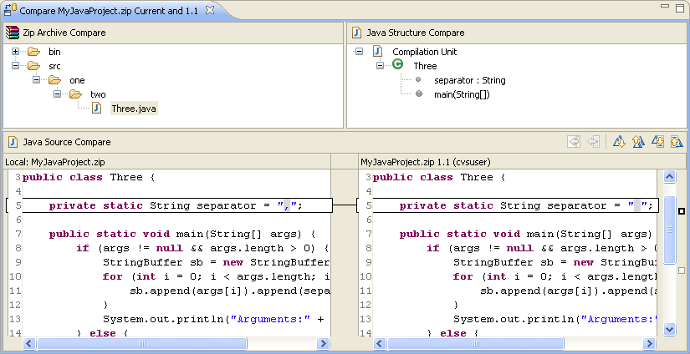
The Panes of a Compare Editor Input

Slide 45
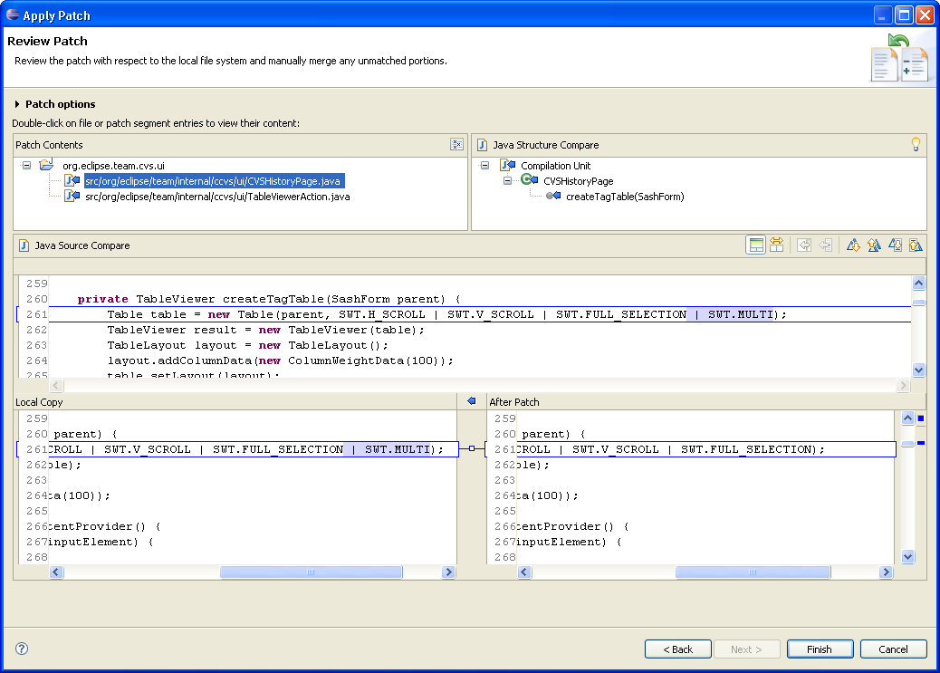
The Panes of the Apply Patch wizard

Slide 46
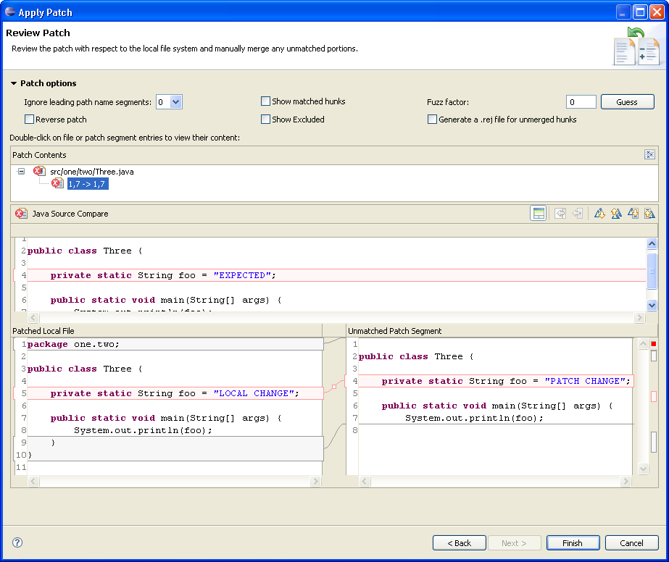
The Ancestor pane in the Apply Patch wizard

Slide 47
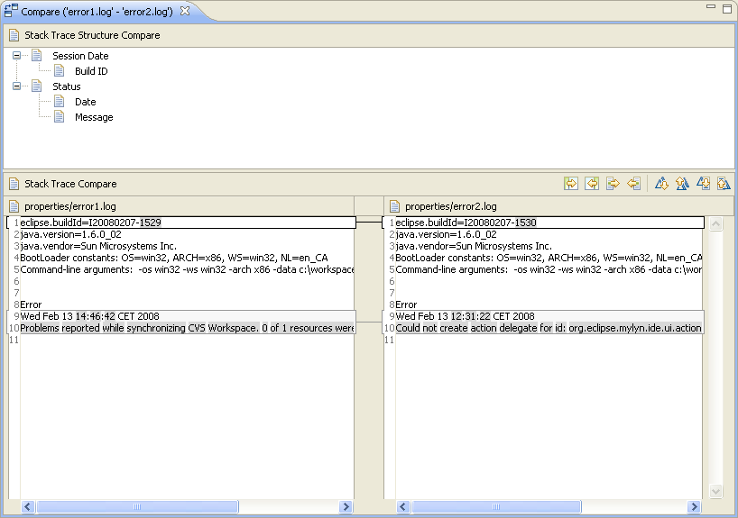
Demo

Slide 48
Additional info and details
Eclipse SDK Help
  Platform Plug-in Developer Guide > Programmer’s Guide > Compare support
Examples
  org.eclipse.compare.examples
  org.eclipse.compare.examples.xml

Slide 49
Web resources and contact
Web
  http://www.eclipse.org
  http://wiki.eclipse.org/Workspace_Team
  http://polishineclipse.blogspot.com
Repository
  :pserver:anonymous@dev.eclipse.org:/cvsroot/eclipse
IRC:
  #eclipse, #eclipse-dev
  SzymonB, z4z4
Mail:
  Szymon.Brandys@pl.ibm.com
  Tomasz.Zarna@pl.ibm.com

Slide 50
Legal Notice
  IBM and the IBM logo are trademarks or registered trademarks of IBM Corporation, in the United States, other countries or both.
  Java and all Java-based marks, among others, are trademarks or registered trademarks of Sun Microsystems in the United States, other countries or both.
  Eclipse and the Eclipse logo are trademarks of Eclipse Foundation, Inc.
  Other company, product and service names may be trademarks or service marks of others.

